Slide 1
Expanding Telemedicine to Offset Cost of Missed Appointments
File created on: 4/18/2022 8:17:47 PM

Slide 2
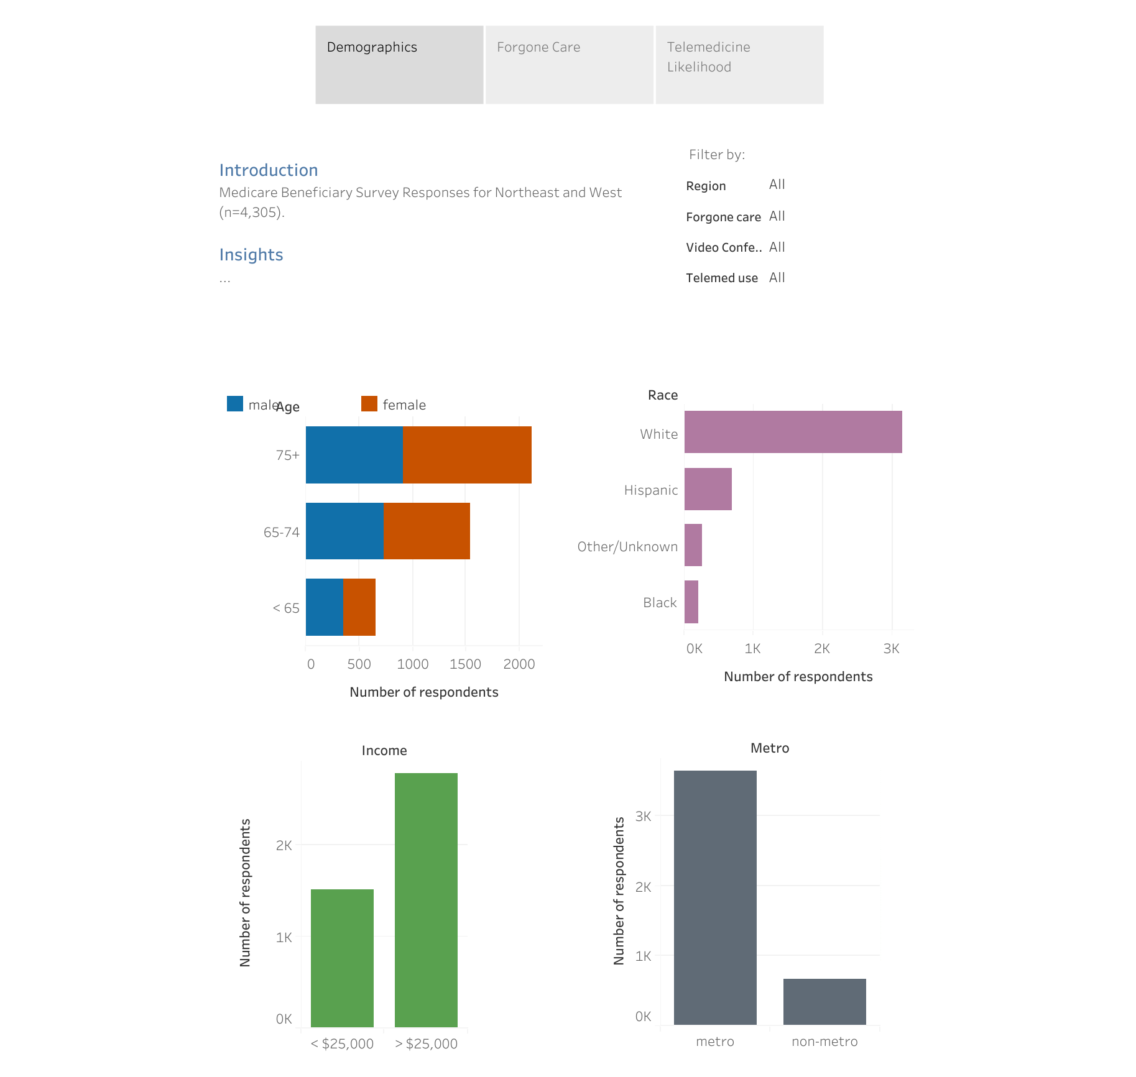

Slide 3
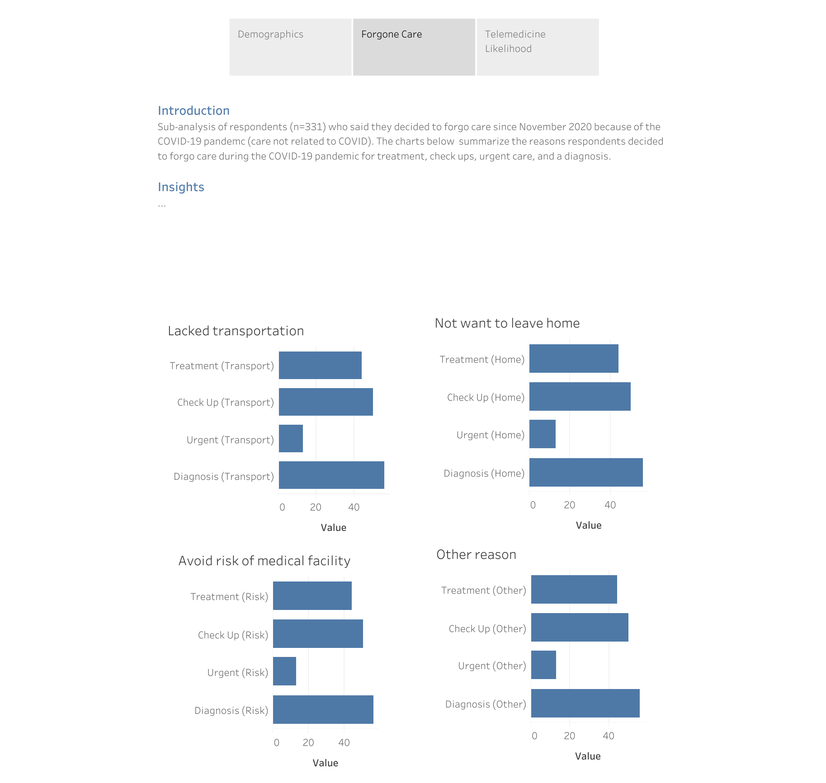

Slide 4
